Slide 1

Case Study 7: Tuberculosis Insights
Presented By Wil Jones

Slide 2
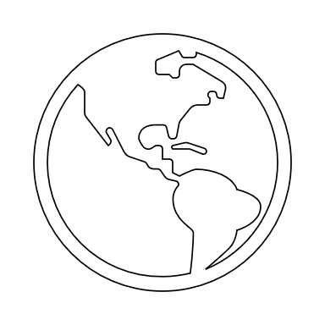

Which countries require our attention?

Slide 3
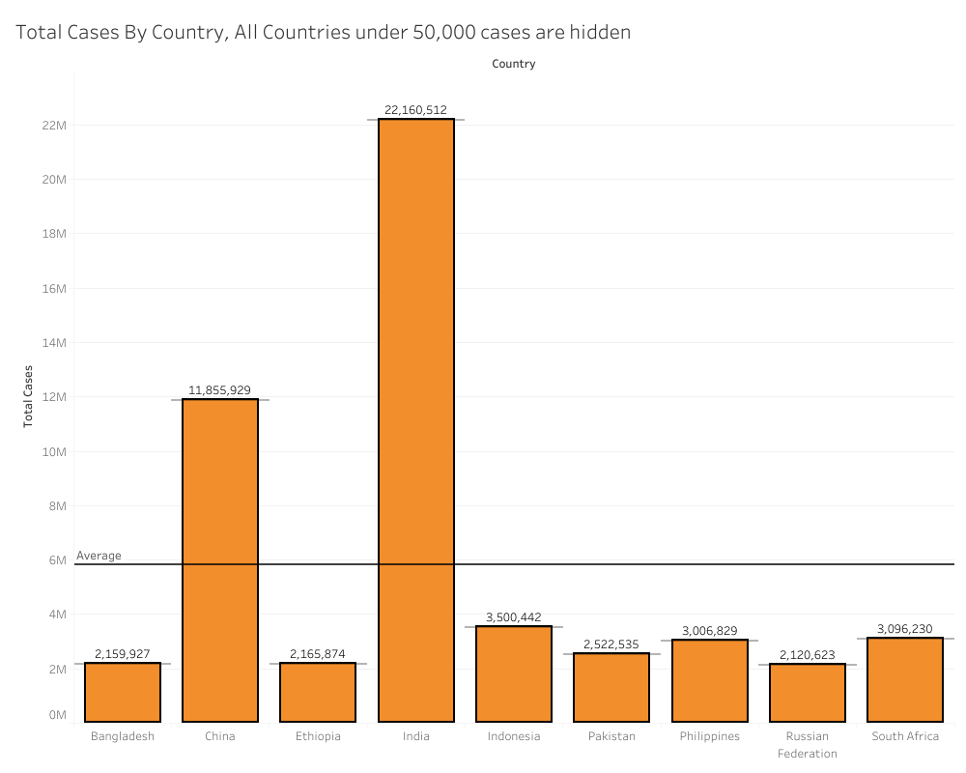

Insights
India and China account for the vast majority of global TB cases.
India leads with 22,160,512 total TB cases, followed by China with 11,855,929.
Other high impact countries include Indonesia, Pakistan, and South Africa.
The countries with the highest case counts are far above the global average, with India being the biggest contributor.

Slide 4


Which age group requires our attention?

Slide 5
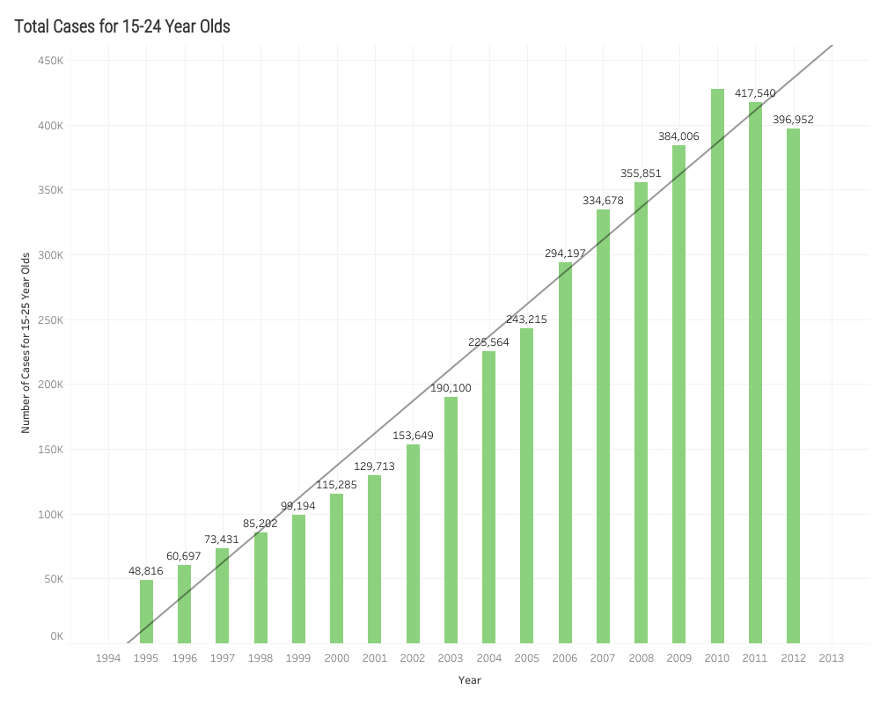
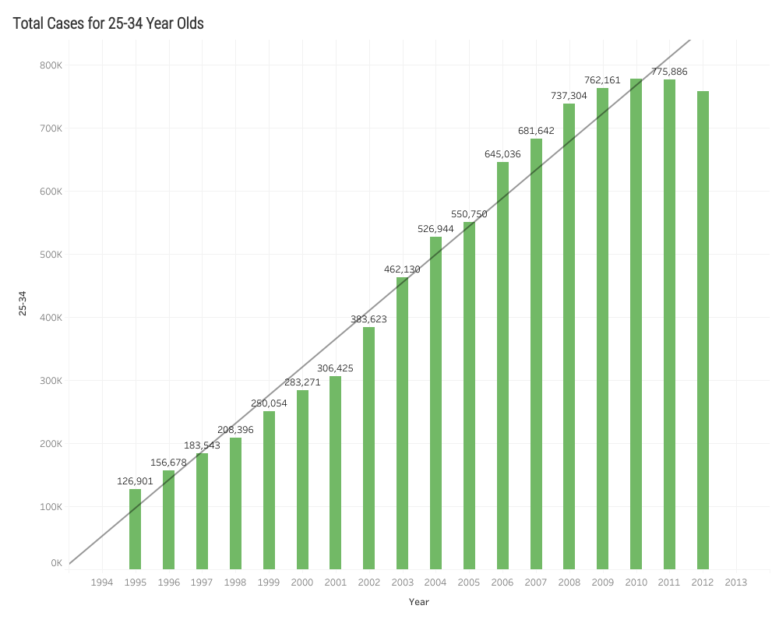

Insights
Between 1994 and 2013, both age groups show a steady rise in TB cases, but the 25–34 cohort consistently reports higher numbers than the 15–24 group. By 2013, 25–34 year olds reach nearly double the number of cases compared to 15–24 year olds, suggesting that TB risk increases further into adulthood. These findings emphasize the need for targeted interventions and preventive strategies tailored to young and middle-aged adults.

Slide 6
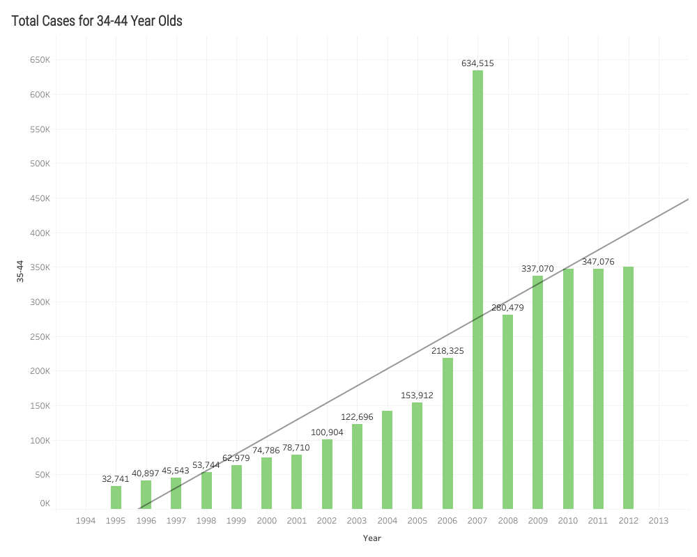

Insights
Both groups show a clear upward trend in TB cases over the years, but 25–34 year olds reach a higher overall peak (~775k cases by 2012–2013). In contrast, 34–44 year olds experience a sharp spike around 2007 (~634k) before cases drop below 350k by 2013. While both age groups remain high-risk, the 25–34 cohort maintains consistently higher total cases throughout this time frame, indicating a particularly critical need for targeted interventions in that age range.

Slide 7



Are there differences between genders?

Slide 8
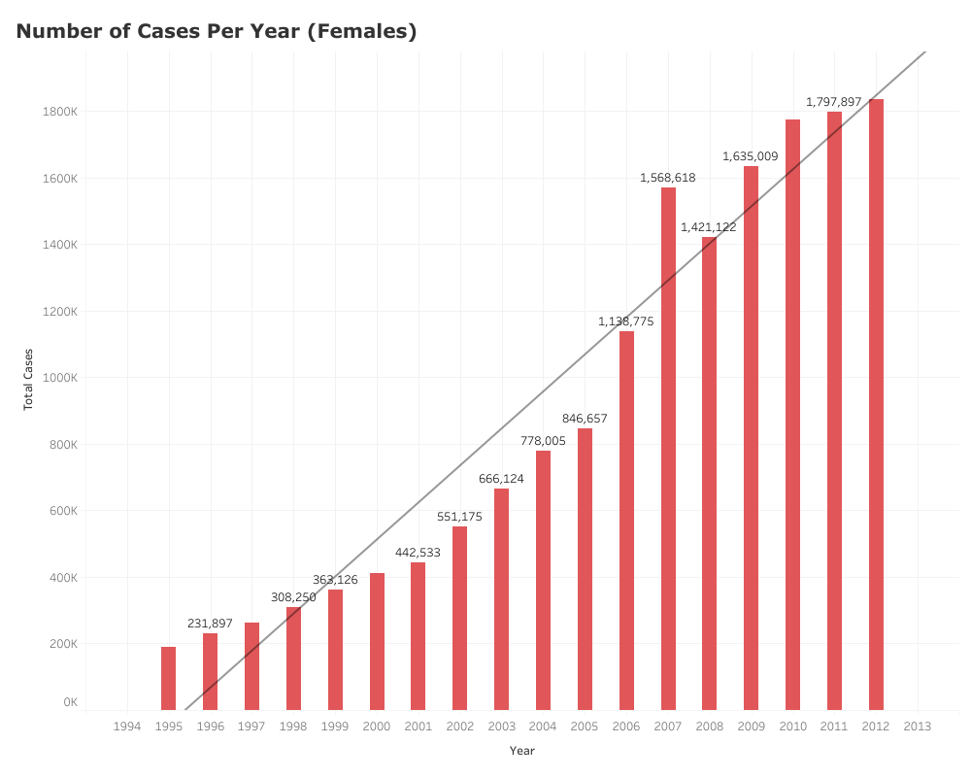
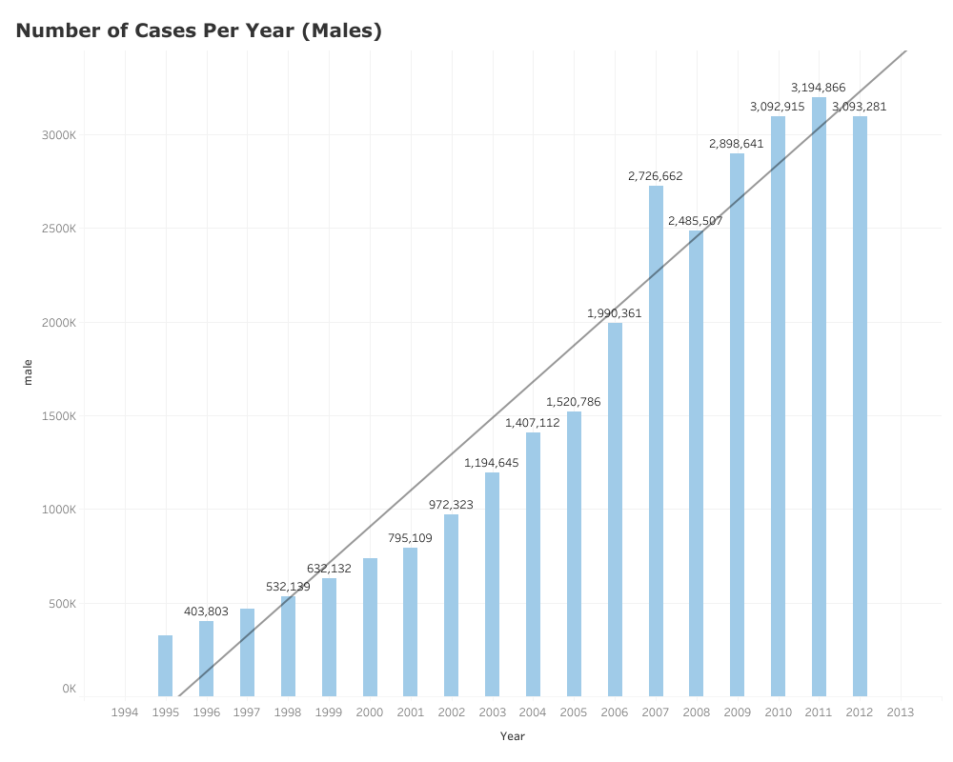

Insights
Both males and females display a steady rise in TB cases over time. However, the male population consistently has higher total cases, exceeding 3 million by 2013, compared to roughly 1.8 million among females in the same year. This gap underscores the importance of gender-specific strategies and interventions, while still recognizing that TB remains a major concern for both groups.

Slide 9


Where do we go from here?

Slide 10

How should we precede after filtering through this data?
After reviewing the data from the World Health Organization’s TB reports, we discovered that much of it is fragmented, inconsistently labeled, and littered with missing values. These problems hinder robust analysis and can lead to misleading conclusions if left unaddressed. Therefore, a thorough cleaning and normalization process is essential to ensure the data is accurate, consistent, and ready for deeper insights.
Python serves as an excellent tool for managing and cleaning messy data before transferring it to a MySQL database. Using libraries like Pandas, analysts can efficiently address missing values, standardize column names, and ensure consistent formats across multiple files. The data can then be normalized (reshaped) for easier querying by transforming wide datasets into a tidy, long format. Once cleaned, Python’s MySQL connectors or SQLAlchemy enable seamless insertion of the resulting tables into a MySQL database, creating a single, centralized source for ongoing analysis and reporting.

